Slide 1
Tutorial

Slide 2
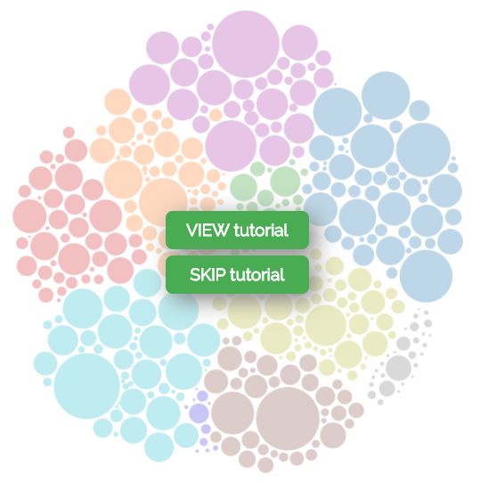
Pave
Is a Canadian
Job Explorer

Slide 3
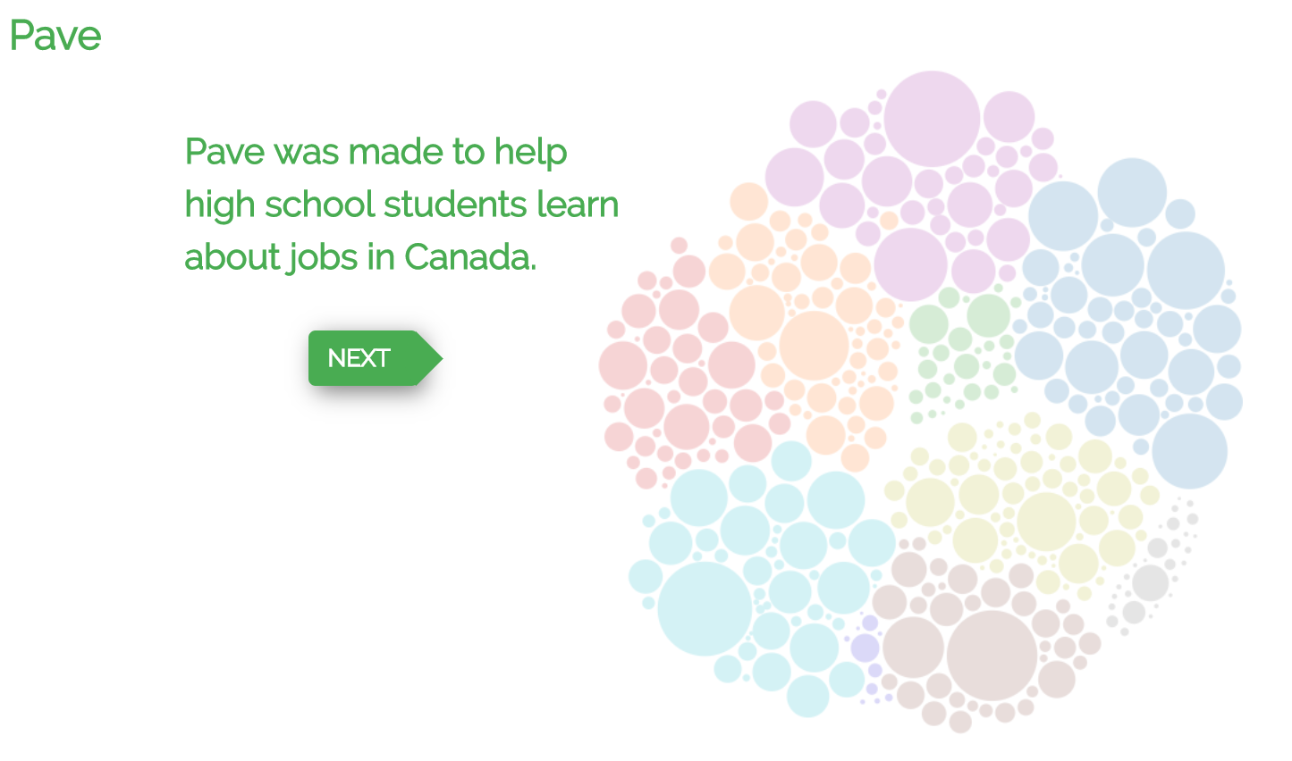



Pave
Tutorial 1 of 5
Pave was made to help simplify career decisions for high school students.
Is a Canadian
Job Explorer

Slide 4


You can use Pave to quickly compare many different careers.
Tutorial 2 of 5

Slide 5
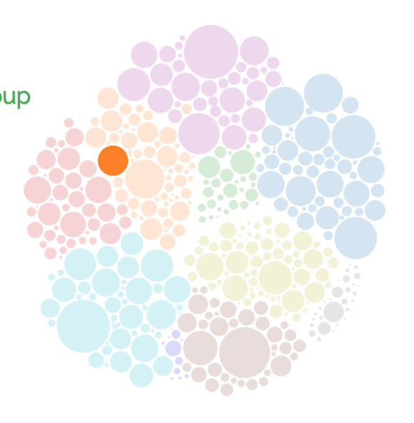

The circles on the right represent job groups. Hover over the circles to see the job group details.
Tutorial 3 of 5

Slide 6


The circles on the right represent job groups. Hover over the circles to see the job group details.
Tutorial 3 of 5
manufacturer

Slide 7
Each circle represents a job group Hover over the circle on the right to see job details Click the circle on the right to see skills used on the job
Tutorial 3 of 5
manufacturer

Slide 8


Each circle represents a job group Hover over the circle on the right to see job details Click the circle on the right to see skills used on the job
Tutorial 3 of 5
manufacturer

Slide 9


Each circle represents a job group Hover over the circle on the right to see job details Click the circle on the right to see skills used on the job
Tutorial 3 of 5
manufacturer
More stuff?!

Slide 10

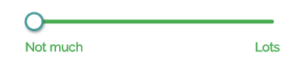
The skill sliders let you look at jobs that use different amounts of various skillsets.
Move the slider handle below to “Lots” to see which jobs use more math skills.
Tutorial 4 of 5

Slide 11
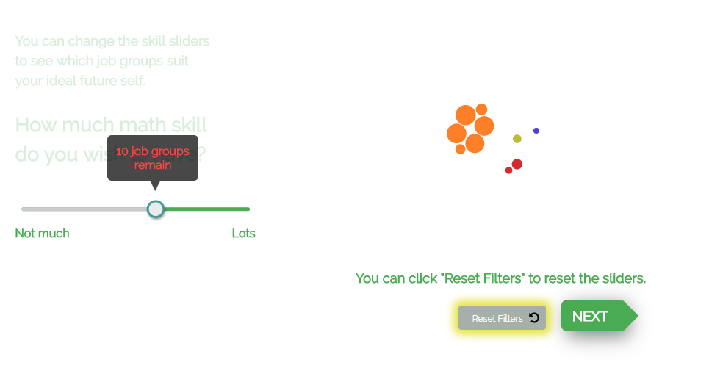
The skill sliders let you look at jobs that use different amounts of various skillsets.
Move the slider handle below to “Lots” to see which jobs use more math skills.
Tutorial 4 of 5

Slide 12

Tutorial 4 of 5

Slide 13
Tutorial 4 of 5

Slide 14

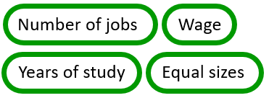
Tutorial 5 of 5
Size by:
options

Slide 15

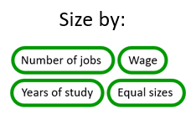

Tutorial 5 of 5
options
Number of Jobs

Slide 16
Main page

Slide 17
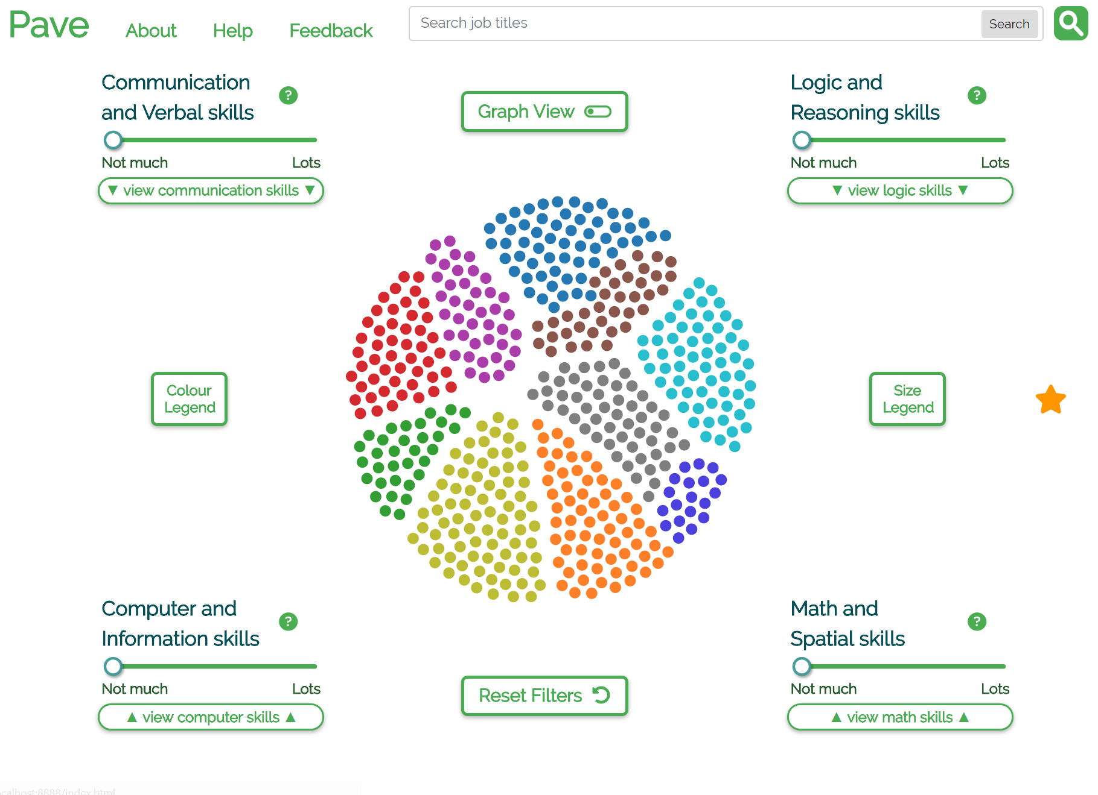
New verbose skill titles (with “inactive text” colour)

Slide 18
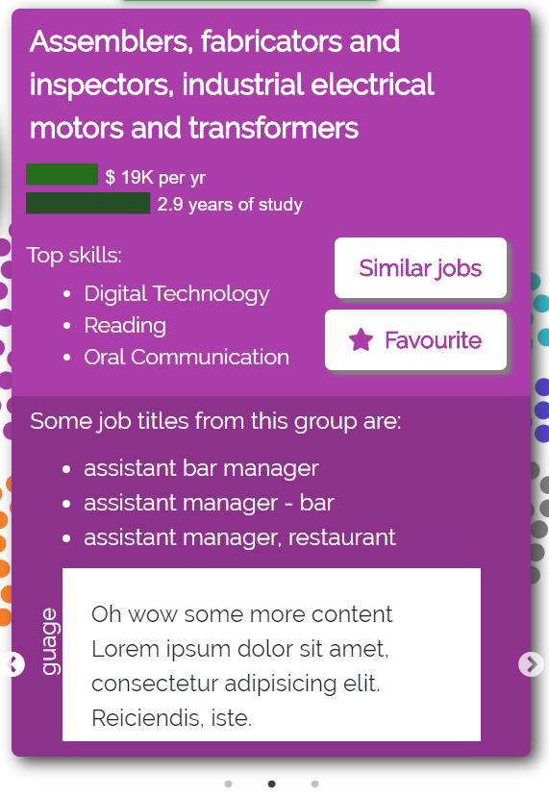
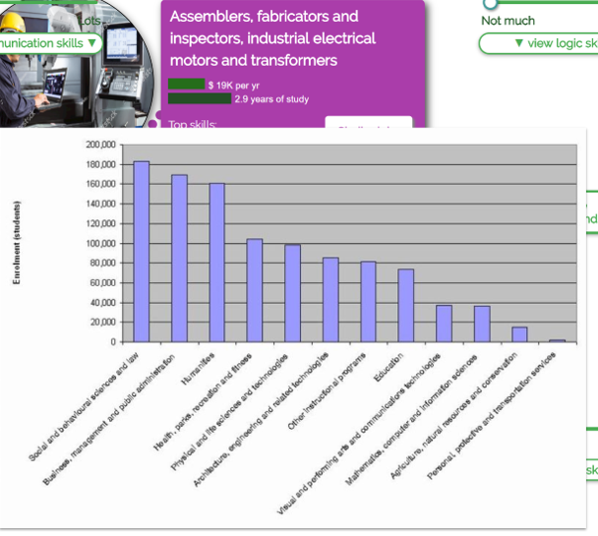
Tooltip currently contains 3 carousel slides (most important first):
Filled map of available program locations (+ tuition cost and/or years of study?)
Zoomable job stats & x/5 star rating
?
2
3
1

Slide 19
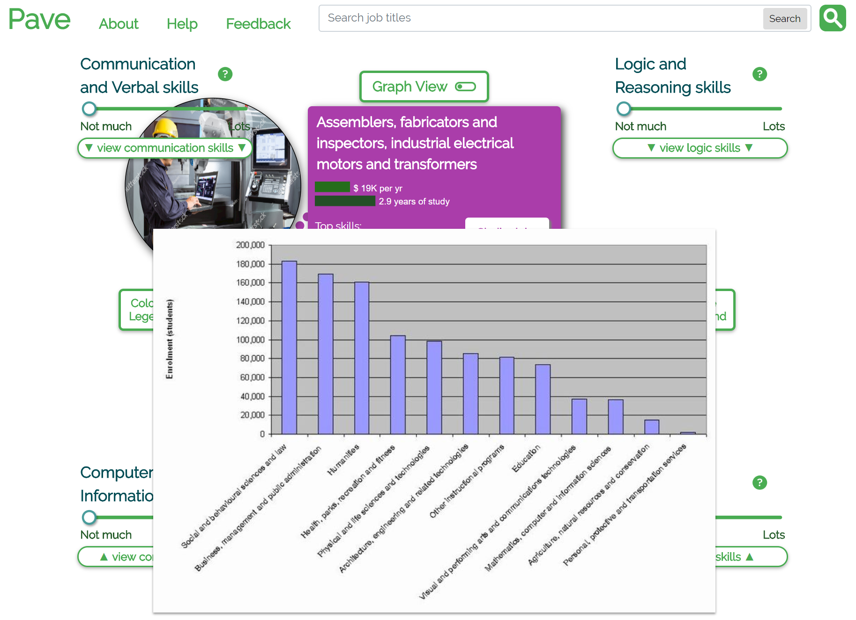
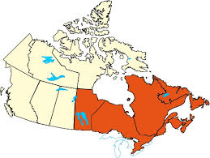
1. Filled map: provinces where programs are available, hover on provinces to show list of {schools, cities}
1

Slide 20
2. Job stats: box
2

Slide 21
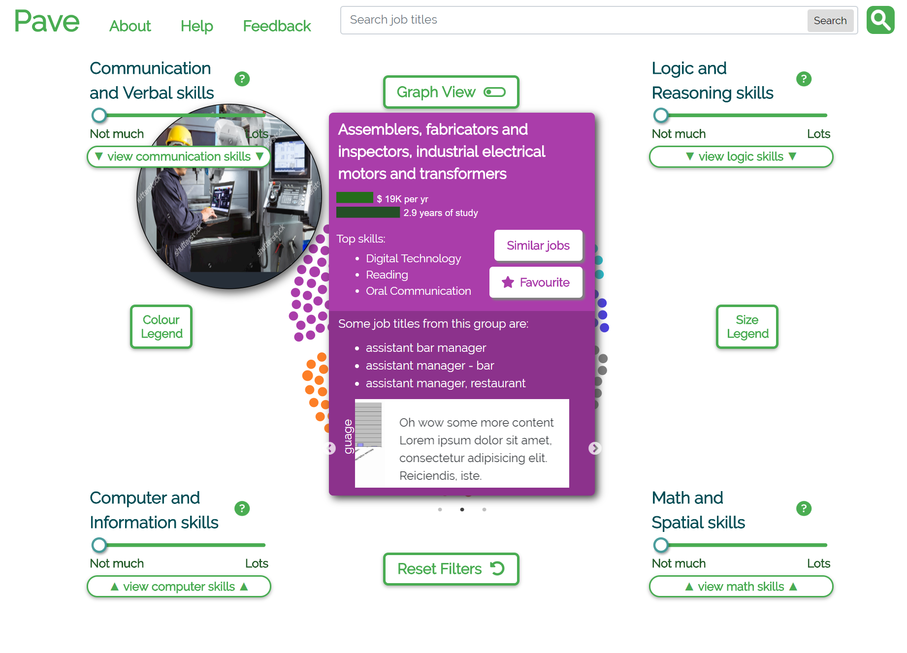

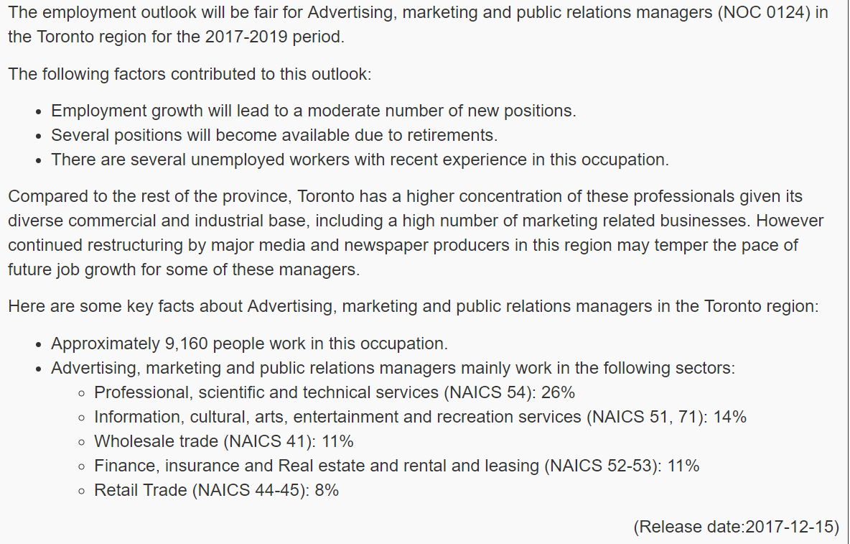
3. Employment outlook (available at https://www.jobbank.gc.ca/LMI_report_area.do;jsessionid=DBC5250FB4D52AF7B09A2E433DD7F737.imnav75?&area=9219&reportOption=outlook )
Select relevant info to include
3

Slide 22
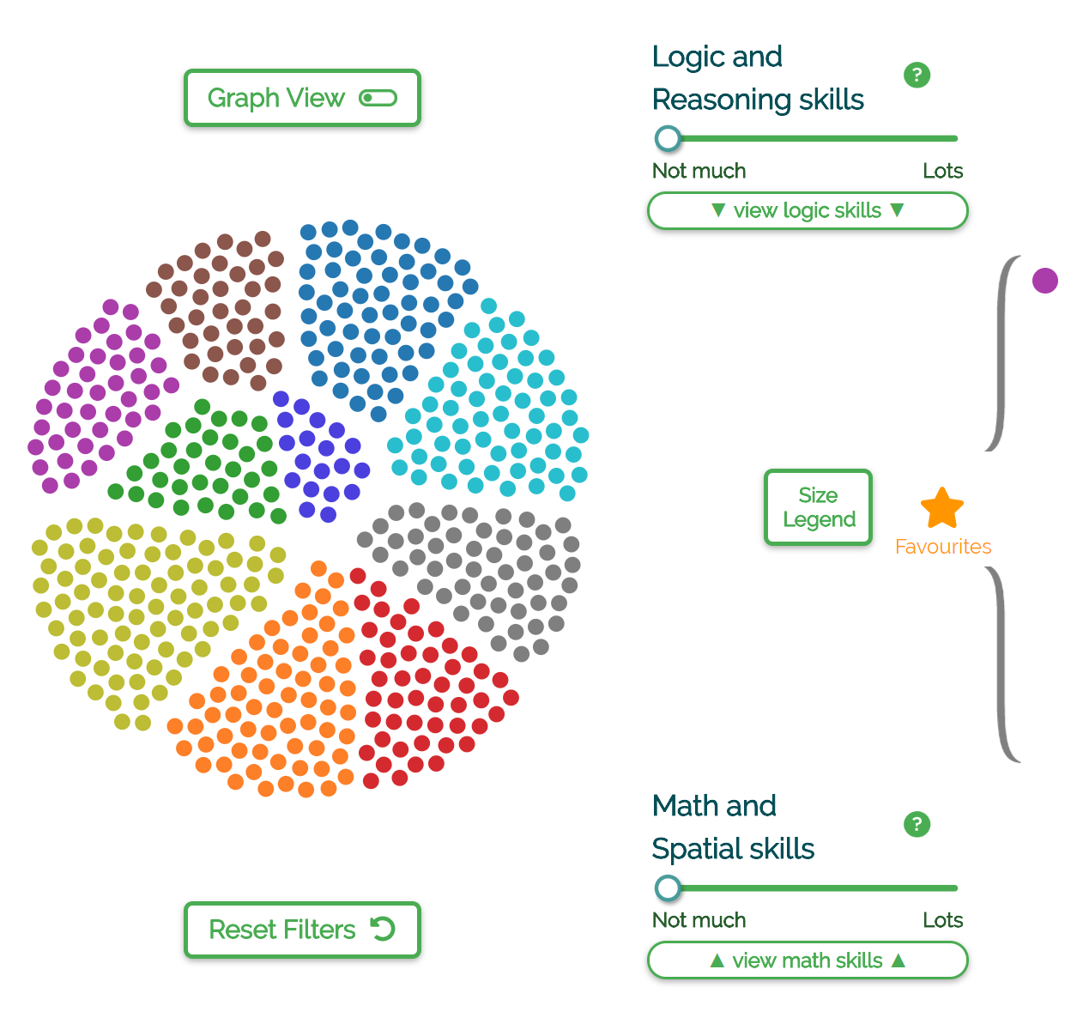
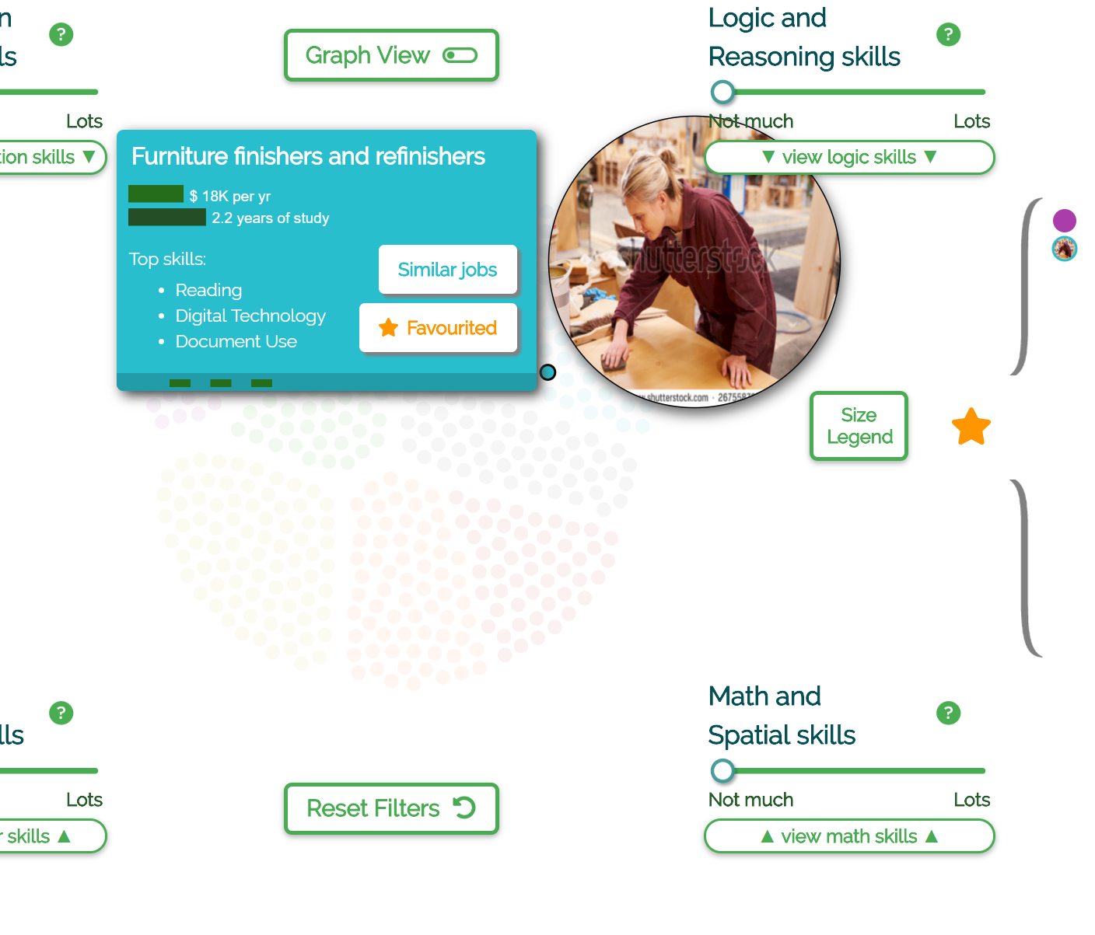
Favourites panel on right side – hover to highlight the favourited job group

Slide 23
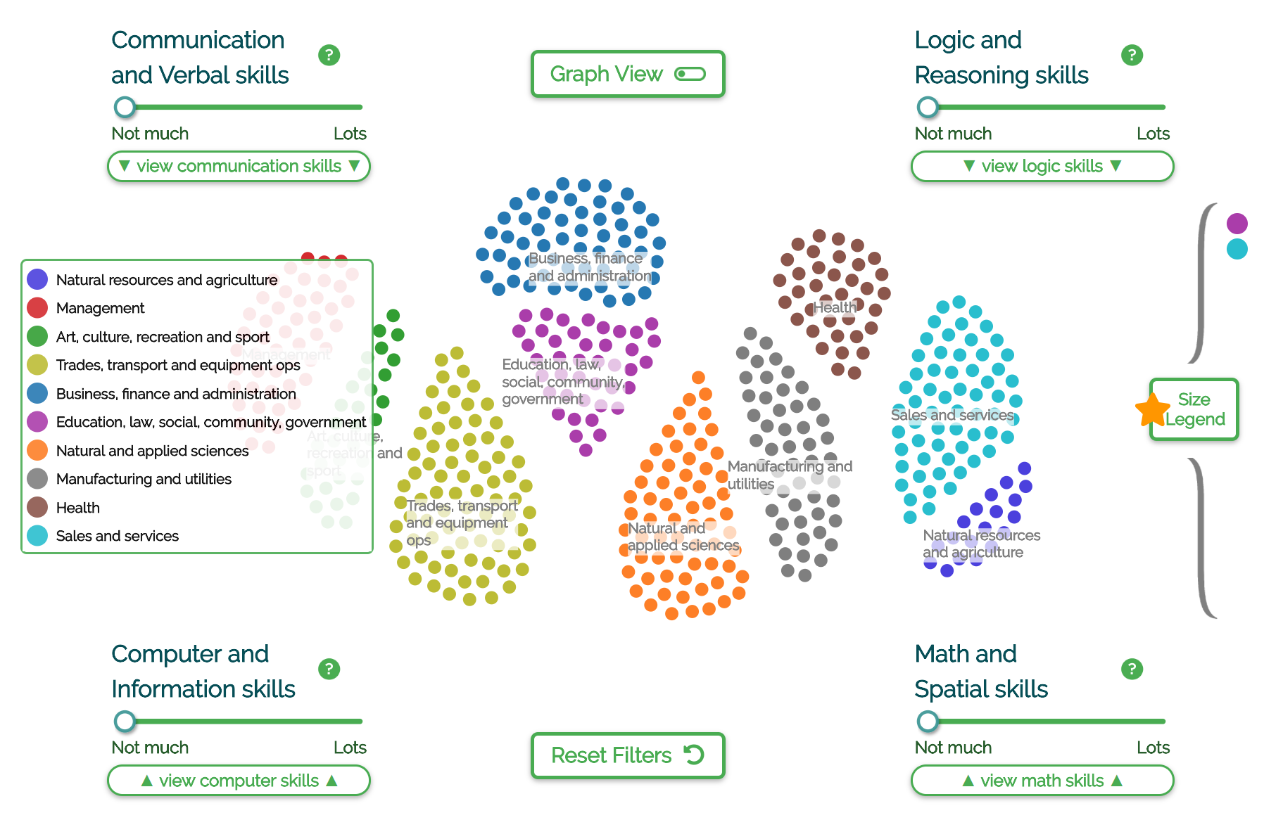
Colour legend with centered labels (should favourites collapse on colour legend click?)

Slide 24
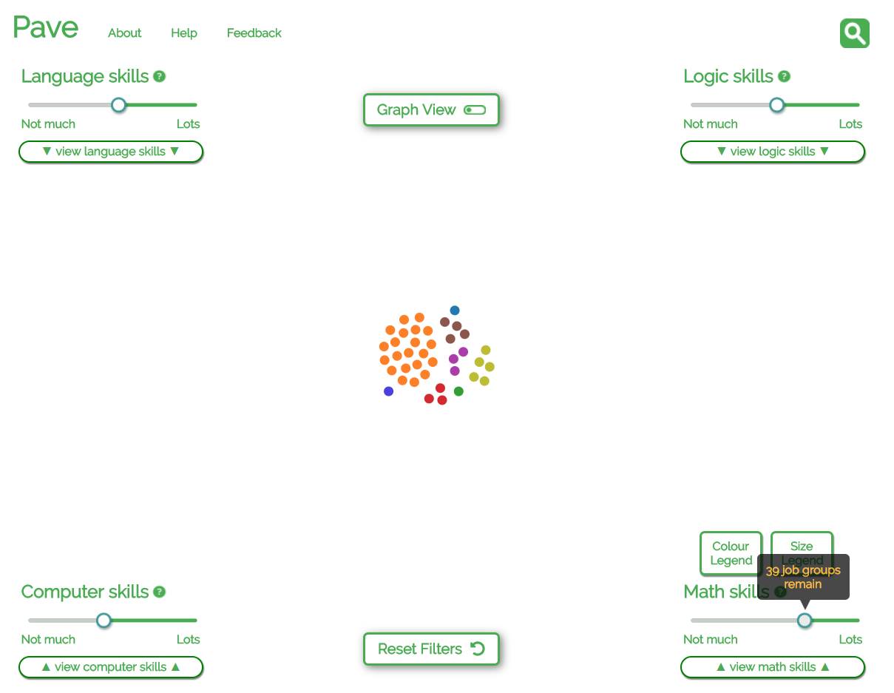

Slide 25
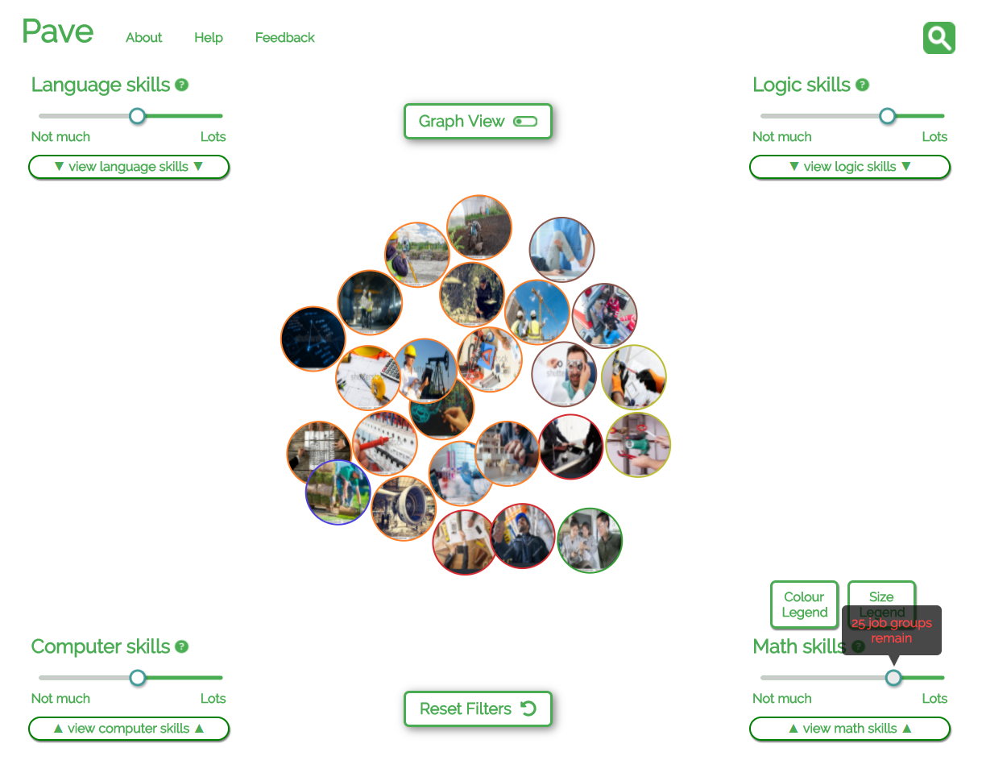

Slide 26
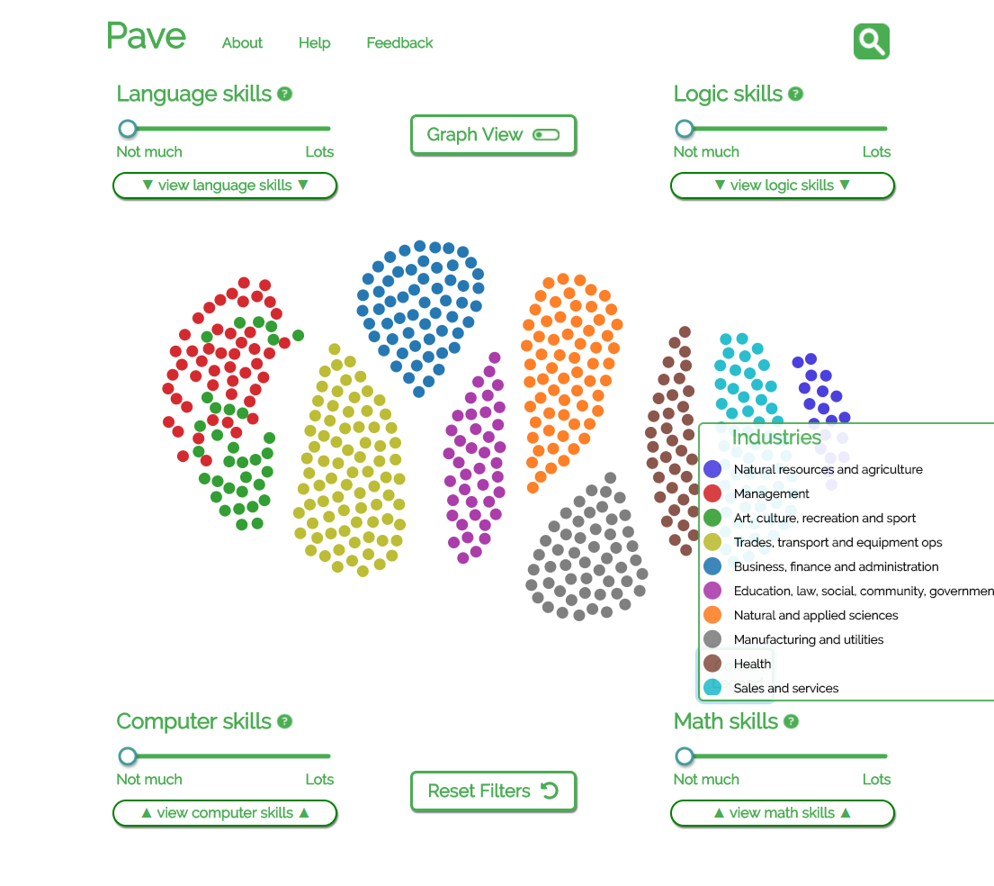
Management

Slide 27
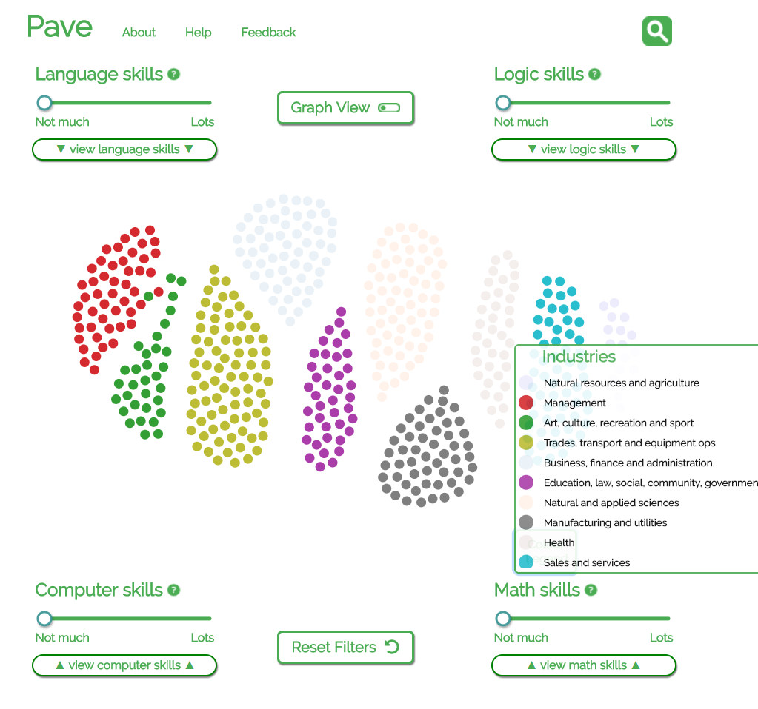
Filter by colour
(need a “reset” button here or add to “Reset Filters” function?)

Slide 28
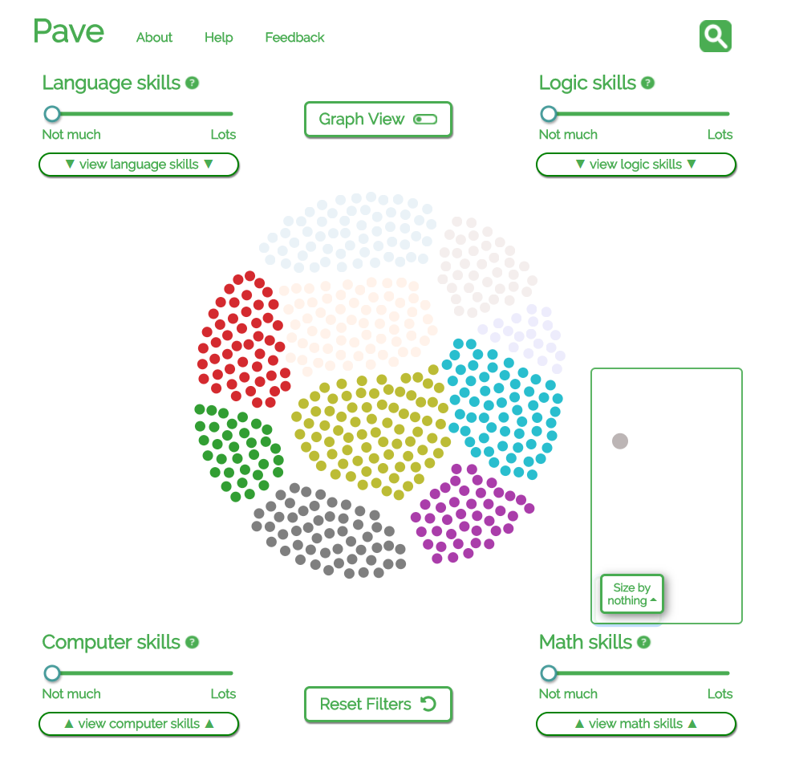
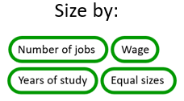

Slide 29
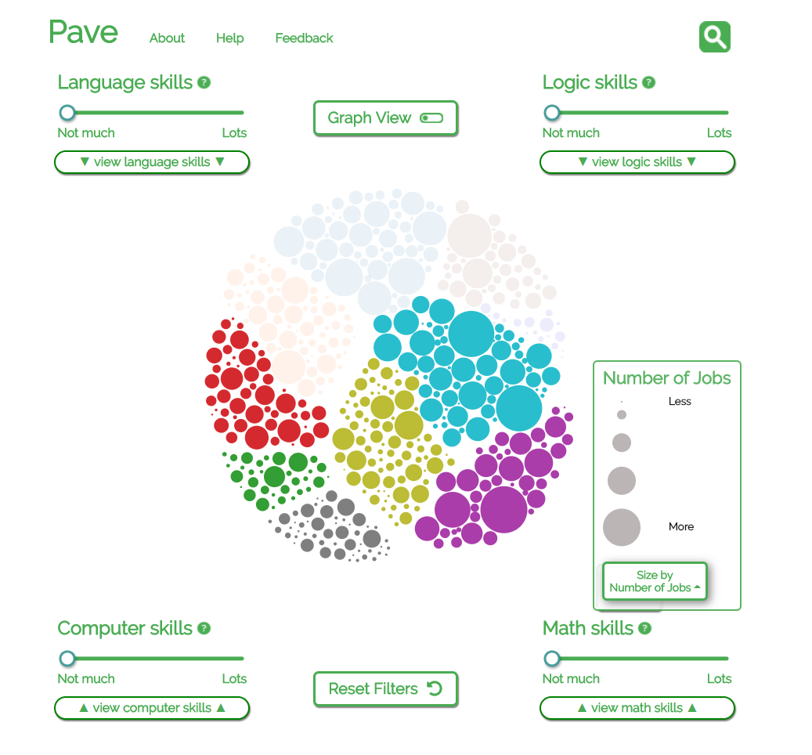
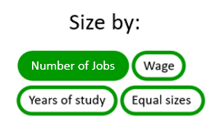

Slide 30
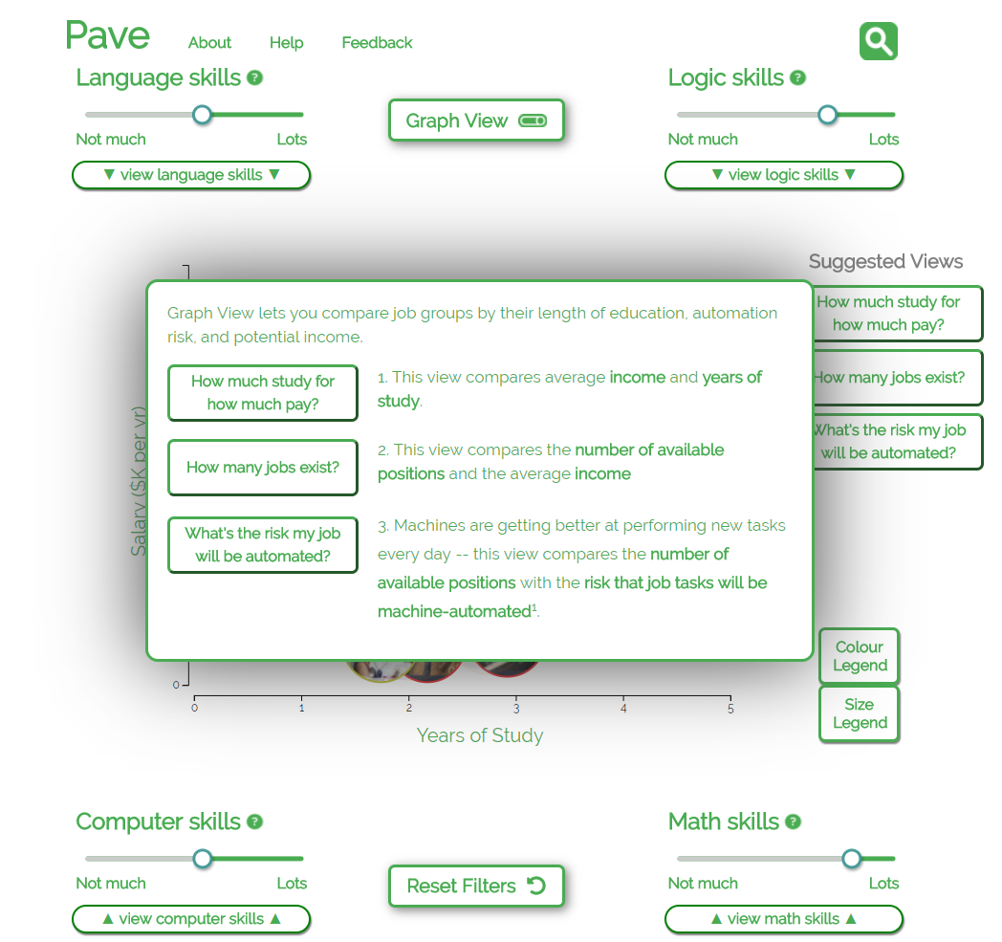
Income
vs.
Years of study [incl. icons]
Income
vs.
Number of jobs
[icon of people]
Machines
vs.
Number of jobs [incl. robot and people]
Usually, jobs that need more education have higher incomes.
Compare average income and years of study.
The more jobs are available, the easier it might be to get hired.
Compare average income and how many jobs are available.
Machines are getting better at performing new tasks every day.
Compare risk that job tasks will be taken over by machines and how many jobs are available.

Slide 31
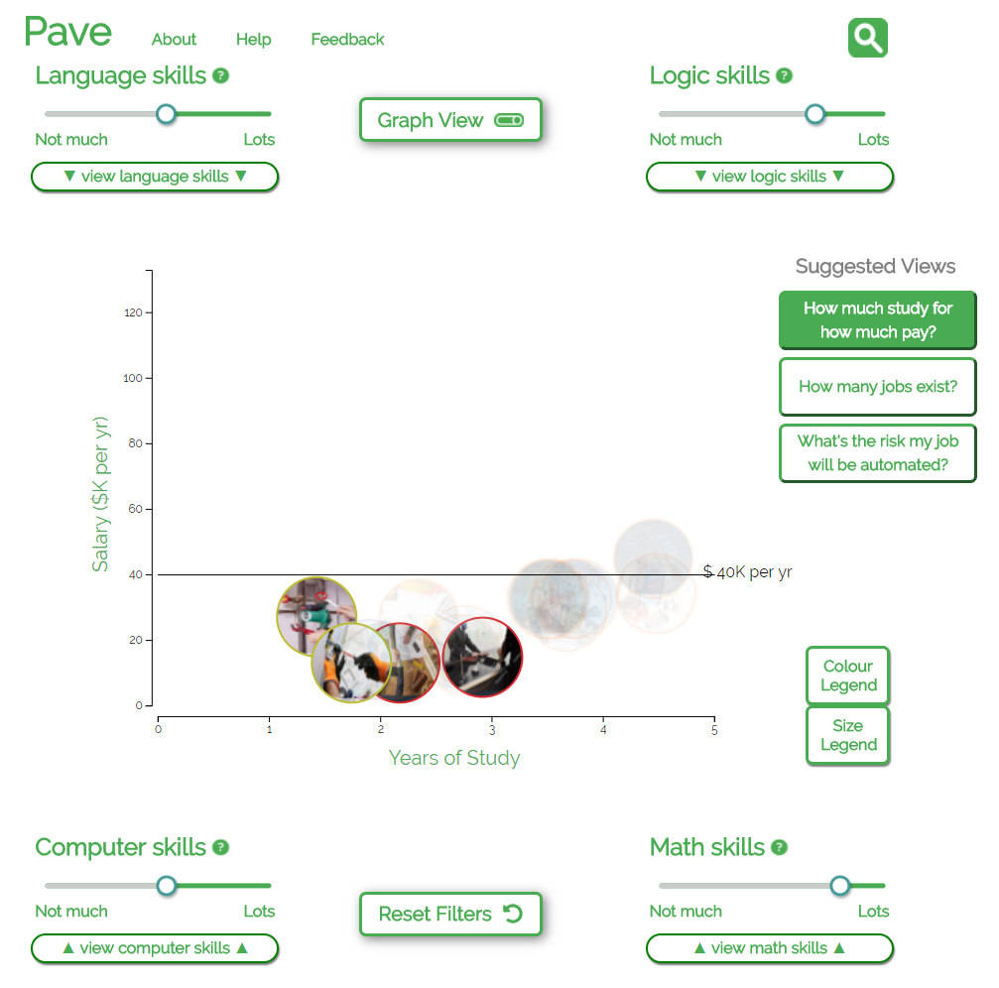
As expected the more a person has studied the greater salary they tend to earn

Slide 32
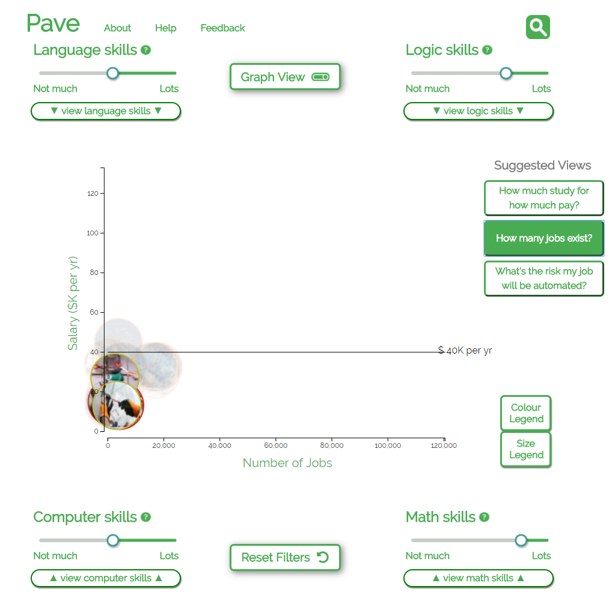

Slide 33
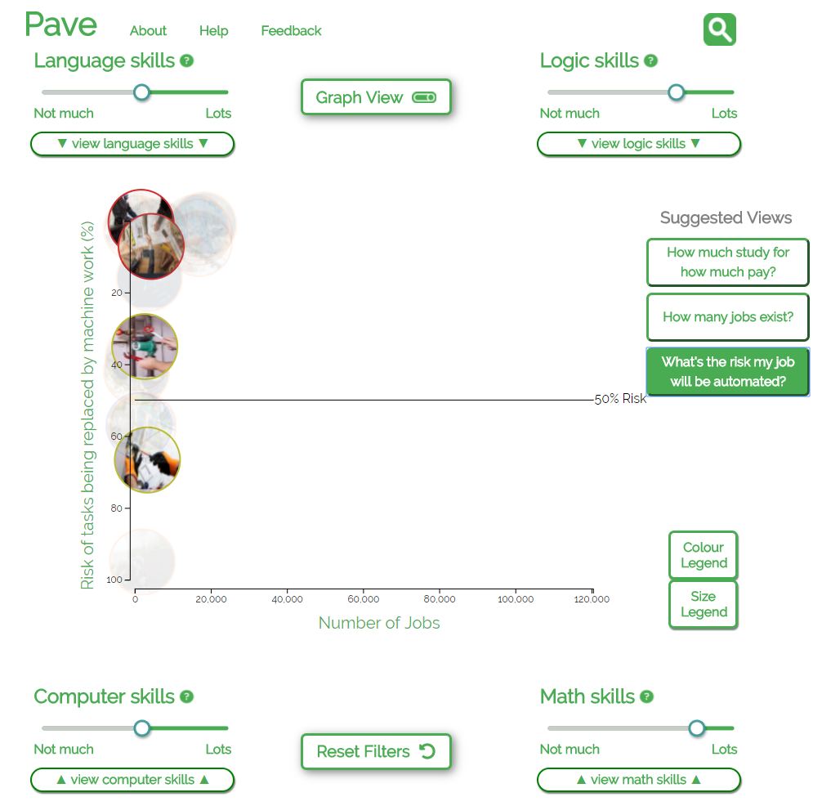

Slide 34
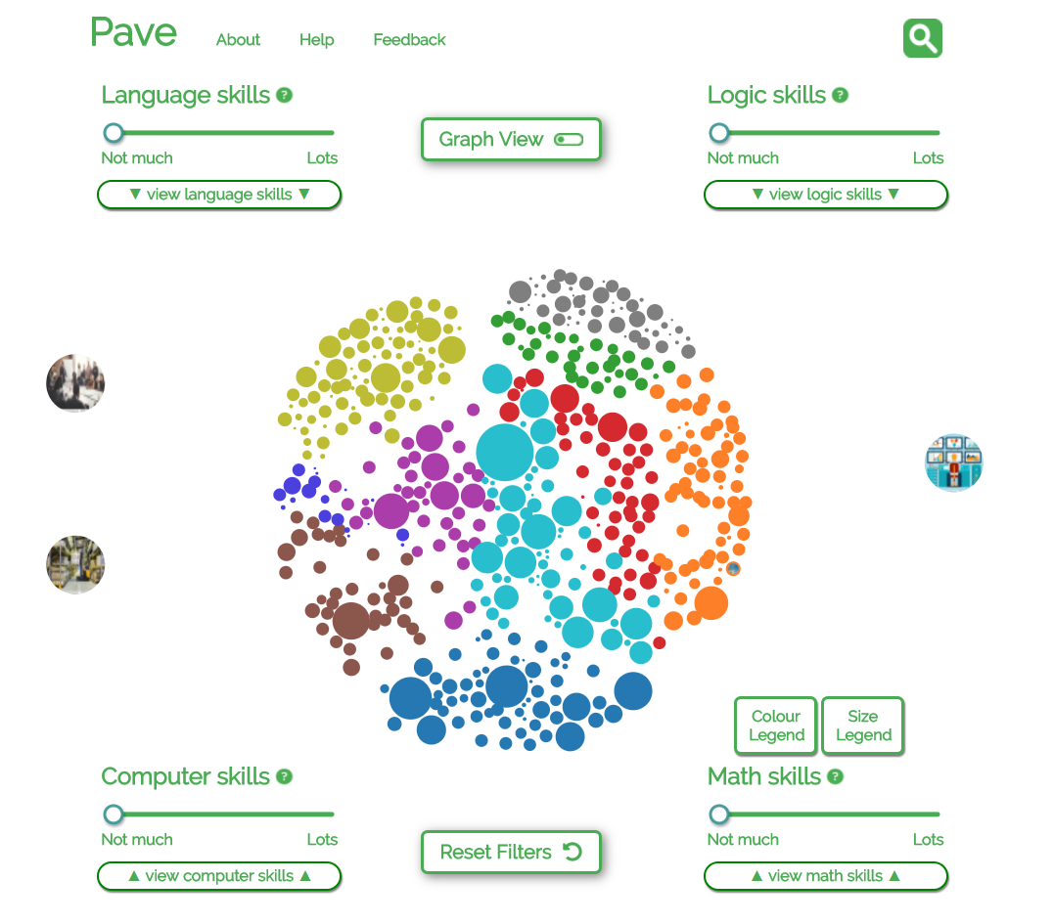
“sticky zones” on sides

